Slide 1
Unique T&C for O365
and other
Cloud Products on SOF
Implementation Demo

Slide 2
Content
Sample SOF documents for O365 and other Cloud products.

Slide 3
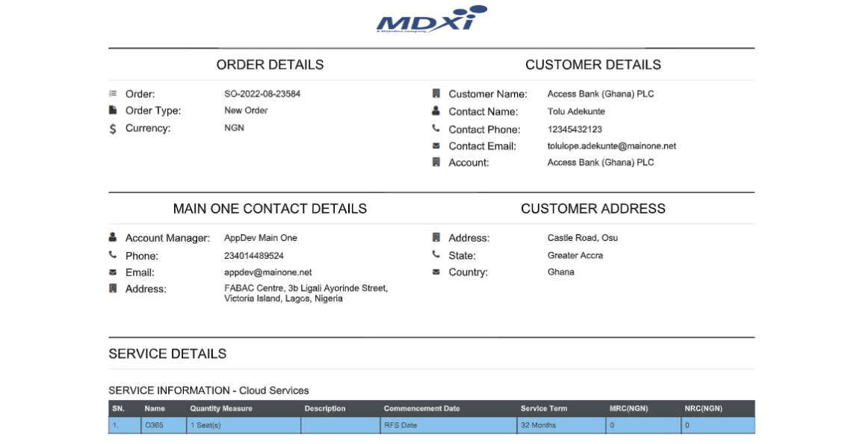
O365

Slide 4
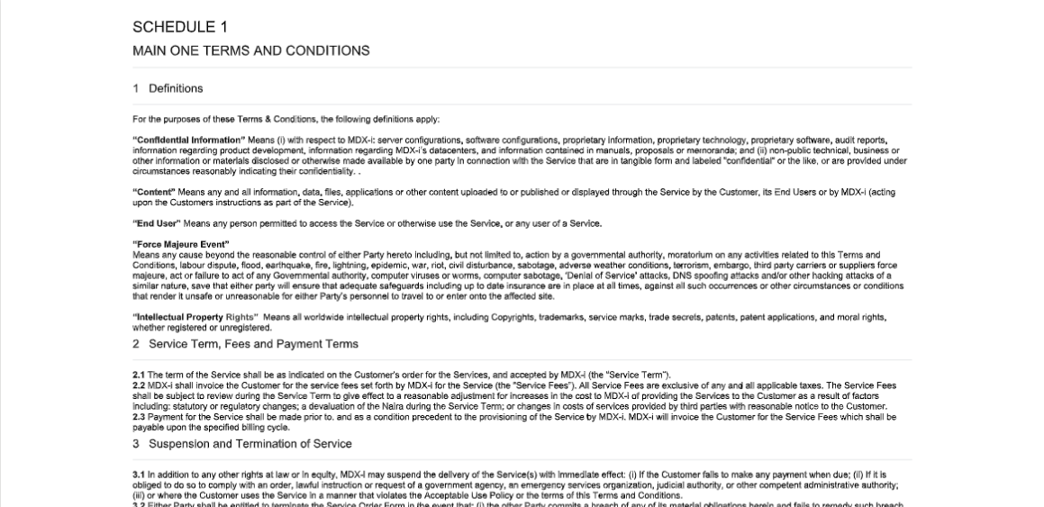
O365

Slide 5
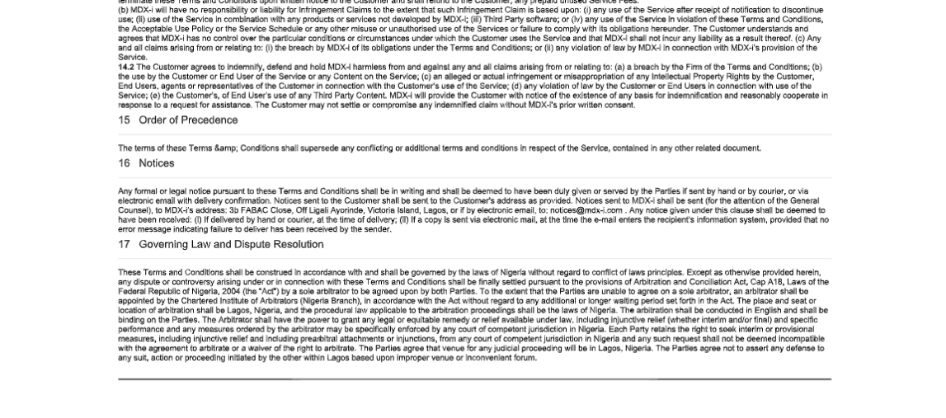
O365

Slide 6
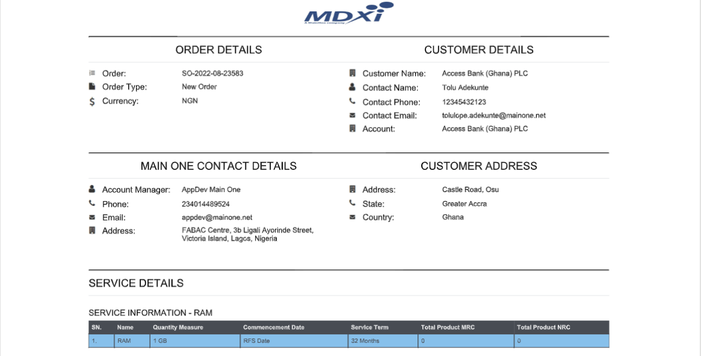
Cloud(RAM)

Slide 7
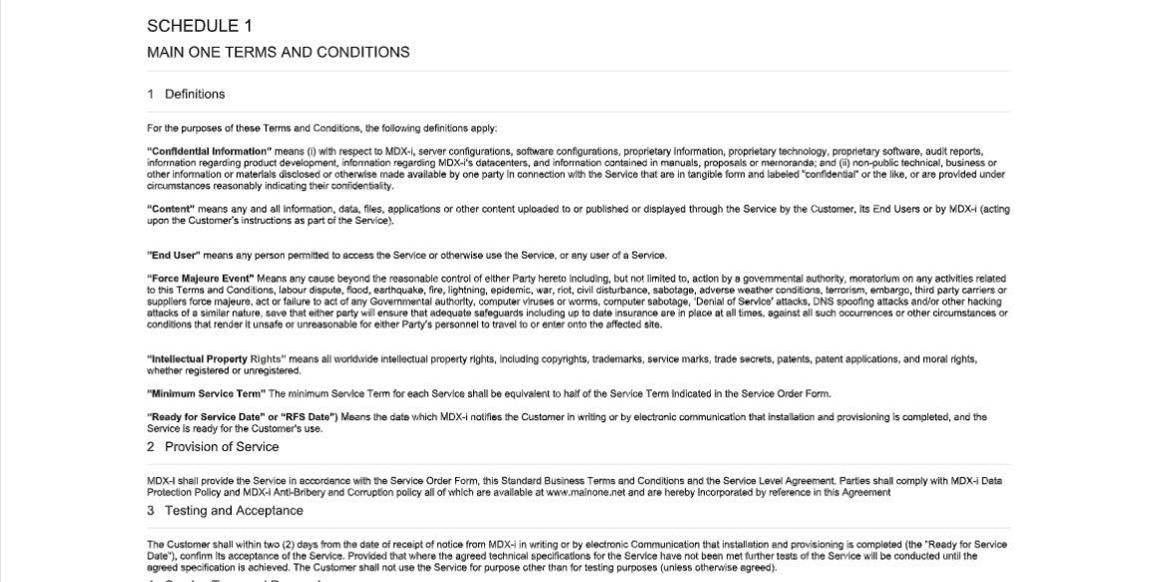
Cloud(RAM)

Slide 8
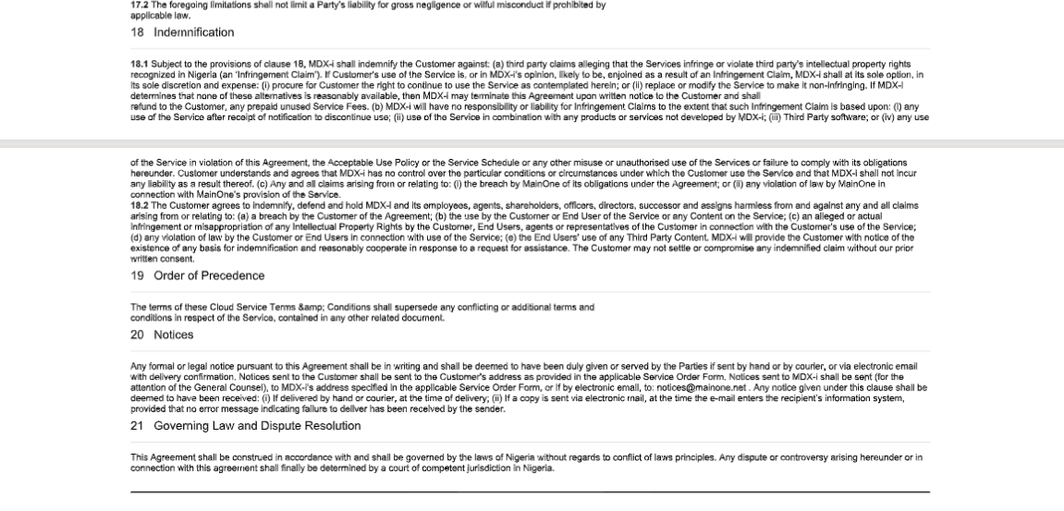
Cloud(RAM)

Slide 9
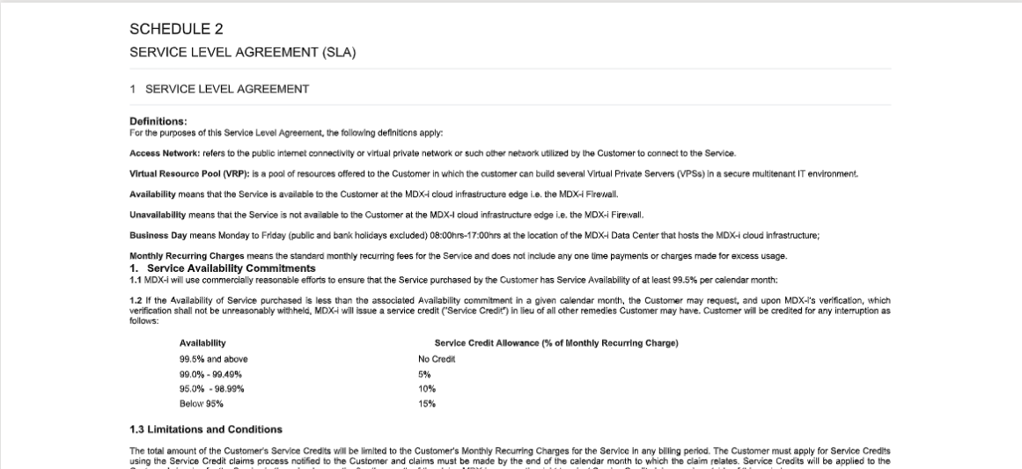
Cloud(RAM)

Slide 10
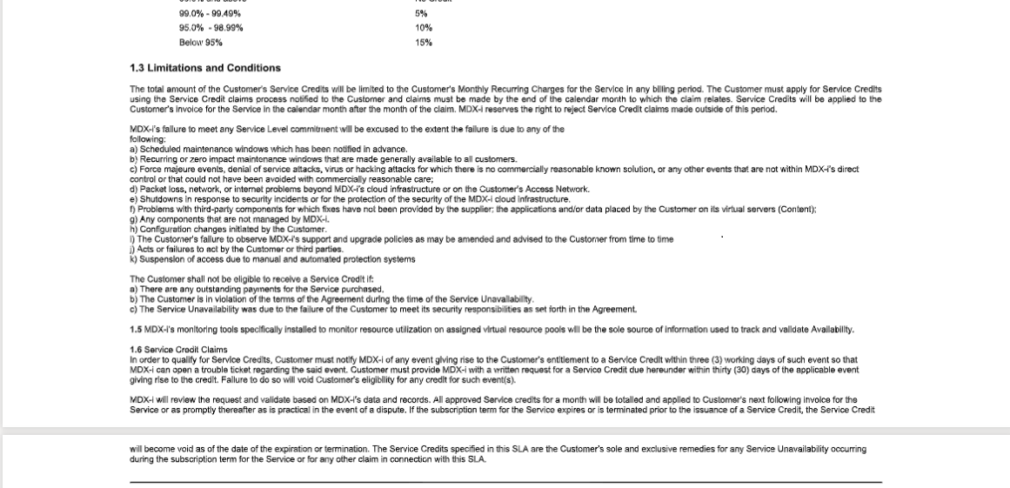
Cloud(RAM)

Slide 11
Thank You

